Slide 1
Database Systems
Lab 03

Slide 2
ORACLE BUILT-IN FUNCTIONS
Functions are a very powerful feature of SQL and can be used to do the following:
Perform calculations on data
Modify individual data items
Manipulate output for groups of rows
Format dates and numbers for display
Convert column data types

Slide 3
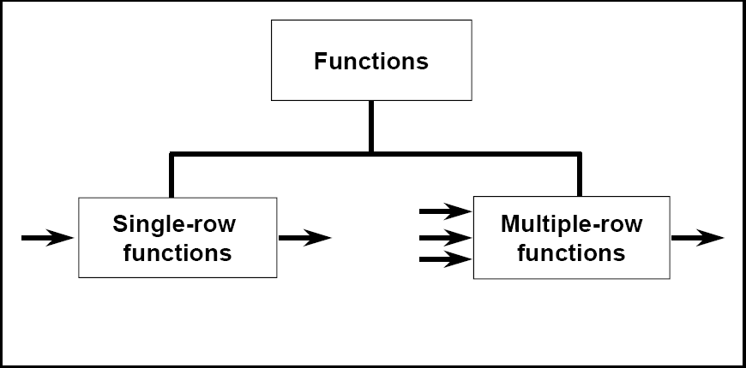
Types of Functions
Single-row functions
Multiple-row functions/Group Functions/Aggregate Functions

Slide 4
Types of Single Row Functions
1) Numeric Functions
These are functions that accept numeric input and return numeric values.
2) Character or Text Functions
These are functions that accept character input and can return both character and number values.
3) Date Functions
These are functions that take values that are of datatype DATE as input and return values of datatype DATE, except for the MONTHS_BETWEEN function, which returns a number.
4) Conversion Functions
These are functions that help us to convert a value in one form to another form. For Example: a null value into an actual value, or a value from one datatype to another datatype like NVL, TO_CHAR, TO_NUMBER, TO_DATE etc.

Slide 5
Nesting of Functions
Combining more than one function together in an expression is known as nesting of functions.
Example:
To display the maximum average salary by nesting group functions
SELECT max(avg(sal)) FROM emp GROUP BY deptno;

Slide 6
Numeric Functions
Function Name | Return Value
ABS (x) | Absolute value of the number 'x'
CEIL (x) | Integer value that is Greater than or equal to the number 'x'
FLOOR (x) | Integer value that is Less than or equal to the number 'x'
TRUNC (x, y) | Truncates value of number 'x' up to 'y' decimal places
ROUND (x, y) | Rounded off value of the number 'x' up to the number 'y' decimal places

Slide 7
Numeric Functions Example
Function Name | Examples | Return Value
ABS (x) | ABS (1) ABS (-1) | 1 1
GREATEST(value1, value2, …) | GREATEST(7,8,10) | 10
LEAST(value1, value2, …) | LEAST(7,8,10) | 7
CEIL (x) | CEIL (2.83) CEIL (2.49) CEIL (-1.6) | 3 3 -1
FLOOR (x) | FLOOR (2.83) FLOOR (2.49) FLOOR (-1.6) | 2 2 -2
TRUNC (x, y) | ROUND (125.456, 1) ROUND (125.456, 0) ROUND (124.456, -1) | 125.4 125 120
ROUND (x, y) | TRUNC (140.234, 2) TRUNC (-54, 1) TRUNC (5.7) TRUNC (142, -1) | 140.23 54 5 140

Slide 8
Character Functions
Function Name | Return Value
LOWER (string_value) | All the letters in 'string_value' is converted to lowercase.
UPPER (string_value) | All the letters in 'string_value' is converted to uppercase.
INITCAP (string_value) | All the letters in 'string_value' is converted to mixed case.
LTRIM (string_value, trim_text) | All occurrences of 'trim_text' is removed from the left of 'string_value'.
RTRIM (string_value, trim_text) | All occurrences of 'trim_text' is removed from the right of'string_value' .
TRIM (trim_text FROM string_value) | All occurrences of 'trim_text' from the left and right of 'string_value' ,'trim_text' can also be only one character long .
SUBSTR (string_value, m, n) | Returns 'n' number of characters from'string_value' starting from the 'm'position.
LENGTH (string_value) | Number of characters in 'string_value'in returned.
LPAD (string_value, n, pad_value) | Returns 'string_value' left-padded with'pad_value' . The length of the whole string will be of 'n' characters.
RPAD (string_value, n, pad_value) | Returns 'string_value' right-padded with 'pad_value' . The length of the whole string will be of 'n' characters.

Slide 9
Character Functions Example
Function Name | Examples | Return Value
LOWER(string_value) | LOWER('Good Morning') | good morning
UPPER(string_value) | UPPER('Good Morning') | GOOD MORNING
INITCAP(string_value) | INITCAP('GOOD MORNING') | Good Morning
LTRIM(string_value, trim_text) | LTRIM ('Good Morning', 'Good) | Morning
RTRIM (string_value, trim_text) | RTRIM ('Good Morning', ' Morning') | Good
TRIM (trim_text FROM string_value) | TRIM ('o' FROM 'Good Morning') | Gd Mrning
SUBSTR (string_value, m, n) | SUBSTR ('Good Morning', 6, 7) | Morning
LENGTH (string_value) | LENGTH ('Good Morning') | 12
LPAD (string_value, n, pad_value) | LPAD ('Good', 6, '*') | **Good
RPAD (string_value, n, pad_value) | RPAD ('Good', 6, '*') | Good**

Slide 10
Date Functions
Function | Result | Description
MONTHS_BETWEEN(’01-SEP-95’, ’11-JAN-94’) | 19.6774194 | Number of months between two dates
ADD_MONTHS(’11-JAN-94’, 6) | ’11-JUL-94’ | Add calendar months to dates
NEXT_DAY(’01-SEP-95’, ‘FRIDAY’) | ’08-SEP-95’ | Next day of the date specified
LAST_DAY(’01-SEP-95’) | ’30-SEP-95’ | Last day of the month
ROUND(TO_DATE(’25-JUL-95’, ‘DD-MON-YY’), ‘MONTH’) | 01-AUG-95 | Round date
ROUND(TO_DATE(’25-JUL-95’, ‘DD-MON-YY’), ‘YEAR’) | 01-JAN-96 | Round date
TRUNC(TO_DATE(’25-JUL-95’, ‘DD-MON-YY’), ‘MONTH’) | 01-JUL-95 | Truncate date
TRUNC(TO_DATE(’25-JUL-95’, ‘DD-MON-YY’), ‘YEAR’) | 01-JAN-95 | Truncate date

Slide 11
Queries
1-Display current Date.
select sysdate from dual;
2-Display your age in days.
select to_date(sysdate)-to_date('10-sep-77') from dual;
3-Display your age in months.
select months_between(sysdate,'10-sep-77') from dual;
4-Display the current date as 15th Augest Friday Nineteen Ninety Seven.
select to_char(sysdate,'ddth Month day year')from dual;

Slide 12
Queries
5-Display the following output for each row fromemp table.
'scott has joined the company on wednesday 13th August ninten nintey.‘
select ENAME||' HAS JOINED THE COMPANY ON'||to_char(HIREDATE,'day ddth Month year') from EMP;
6-Find the date for nearest saturday after current date.
SELECT NEXT_DAY(SYSDATE,'SATURDAY')FROM DUAL;
7-display current time.
select to_char(sysdate,'hh:MM:ss') from dual;
8-Display the date three months Before the current date.
select add_months(sysdate,3) from dual;

Slide 13
Conversion Functions
Function Name | Return Value
TO_CHAR (x [,y]) | Converts Numeric and Date values to a character string value. It cannot be used for calculations since it is a string value.
TO_DATE (x [, date_format]) | Converts a valid Numeric and Character values to a Date value. Date is formatted to the format specified by 'date_format'.
NVL (x, y) | If 'x' is NULL, replace it with 'y'. 'x' and 'y'must be of the same datatype.
DECODE (a, b, c, d, e, default_value) | Checks the value of 'a', if a = b, then returns'c'. If a = d, then returns 'e'. Else, returnsdefault_value.

Slide 14
Conversion Functions Example
Function Name | Examples | Return Value
TO_CHAR () | TO_CHAR (3000, '$9999') TO_CHAR (SYSDATE, 'Day, Month YYYY') | $3000 Monday, June 2008
TO_DATE () | TO_DATE ('01-Jun-08') | 01-Jun-08
NVL () | NVL (null, 1) | 1

Slide 15
To_Char Function
Using the to_char function with dates
SELECT empno, to_char(hiredate, 'MM/YY') Month_hired from emp;
‘DAY’ = DAY

Slide 16
Conversion Of NULL values
SELECT ename,NVL(comm,0),NVL2(comm,sal+comm,sal)as Income FROM emp;
NVL converts a NULL value to an actual value in this e.g to zero
NVL2: if commission is not null then return salary + commission else if commission is
Null then return salary

Slide 17
Grouping Functions
FUNCTIONS | DESCRIPTION
AVG(col-name) | The AVG() Func returns the average value of a numeric column.
MIN(col-name) | The min() func returns the smallest value of the selected column.
MAX(col-name) | The max() func returns the largest value of the selected column.
SUM(col-name) | Returns the total sum of a numeric column.
FIRST(COL-NAME) | Returns the First value of the selected column.
LAST(COL-NAME) | Returns the Last value of the selected column.

Slide 18
Grouping Functions Example
To show the average salary, minimum salary, maximum salary and count of employees in the organization
SELECT AVG (SAL), MIN(SAL), MAX(SAL), COUNT(*) FROM EMP;
To show the minimum and maximum hiredate for employees
SELECT MIN (hiredate), MAX(hiredate) FROM emp;
To return the number of rows in a table
SELECT COUNT(*) FROM emp WHERE deptno = 30;
To return the number of nonnull rows in a table
SELECT COUNT(comm) FROM emp WHERE deptno = 30;
The group function like AVG do not include null rows. The NVL function forces group functions to include null values.
SELECT AVG(NVL(comm, 0)) FROM emp;

Slide 19
DISTINCT and ALL keyword
Grouping functions may include either of the keywords DISTINCT or ALL. ALL is the default if neither is specified and uses all selected rows in the calculation. DISTINCT uses only one row for each value in the calculation.
Example:
AVG(ALL 2,2,3,3,4) and AVG(2,2,3,3,4) both return 2.8.
AVG(DISTINCT 2,2,3,3,4) returns 3

Slide 20
Group By Statement
The GROUP BY statement is used in conjunction with the aggregate functions to group the result-set by one or more columns.
SQL GROUP BY Syntax
SELECT column_name, aggregate_function(column_name) FROM table_name WHERE column_name operator value GROUP BY column_name

Slide 21
Group By Examples
To show the department-wise average salary
SELECT deptno, AVG(sal) AVERAGE_SALARY FROM emp GROUP BY deptno;
To show the job-wise total salary for each department
SELECT deptno, job, sum(sal) FROM emp GROUP BY deptno, job;

Slide 22
Having Clause
In the same way that we use the WHERE clause to restrict the rows that we select, the HAVING clause is used to restrict groups. First the group function is applied and the groups matching the HAVING clause are displayed.
Syntax:
SELECT column, group_function
FROM table
[WHERE condition]
[GROUP BY group_by_expression] [HAVING group_condition] [ORDER BY column];

Slide 23
Having Examples
To show the department-wise average and maximum salary, in the descending order of average salary, for all departments having average salary higher than 4500.
SELECT DEPTNO, AVG(SAL), MAX(SAL) FROM EMP GROUP BY DEPTNO HAVING AVG(SAL) > 2000 ORDER BY AVG(SAL)
To display the job title and total monthly salary for each job title with a total payroll exceeding 5000.
SELECT JOB, SUM(SAL) PAYROLL FROM EMP WHERE JOB NOT LIKE 'SALES%' GROUP BY JOB HAVING SUM(SAL) > 5000ORDER BY SUM(SAL);

